Slide 1
Cost Optimization Technique Particle Swarm Optimization(PSO)

Slide 2

INTRODUCTION
Particle swarm optimization(PSO) is one of the nature-inspired population-based algorithms which utilize the swarm intelligence to find a better solution in the complete problem search space.
It is a meta-heuristic powerful technique of optimization that concerns the finding of maxima or minima of functions in the possible region.
Main objective is to study all the existing algorithms and analyze algorithm for multidimensional optimization in less amount of time and to reduce the number of running physical systems thereby increasing the power efficiency of the whole data center.

Slide 3
Parameters of PSO
In a PSO multiple candidate solutions exist and collaborate continuously, solution is named as a particle and flies in the given problem space searching for the optimal position.
A particle modifies its position as it moves from one place to another place. Its position changes according to its own experience and the experience of its neighbors. PSO is a combination of local search and the global search methods based on the particle experience in the problem search space, i.e., each iteration particle tries to update its best position.
A particle status is represented by two factors: particle’s position and its velocity. The new velocity and the particle’s position will be updated in each iteration.

Slide 4
Parameters of PSO
We use PSO to where each particle maintains a local best and a global best solutions, and after n fixed number of iterations, the global best solution is the selected Data center where the virtual machine will be placed.
The main objective is to place the requested Virtual machines in such a way to reduce the number of active Data centers and the total power consumption of the data center.
Being an approximation algorithm, PSO performs better when there are a lot of Virtual Machine instances to be allocated on an active Data center while satisfying the given objective.

Slide 5
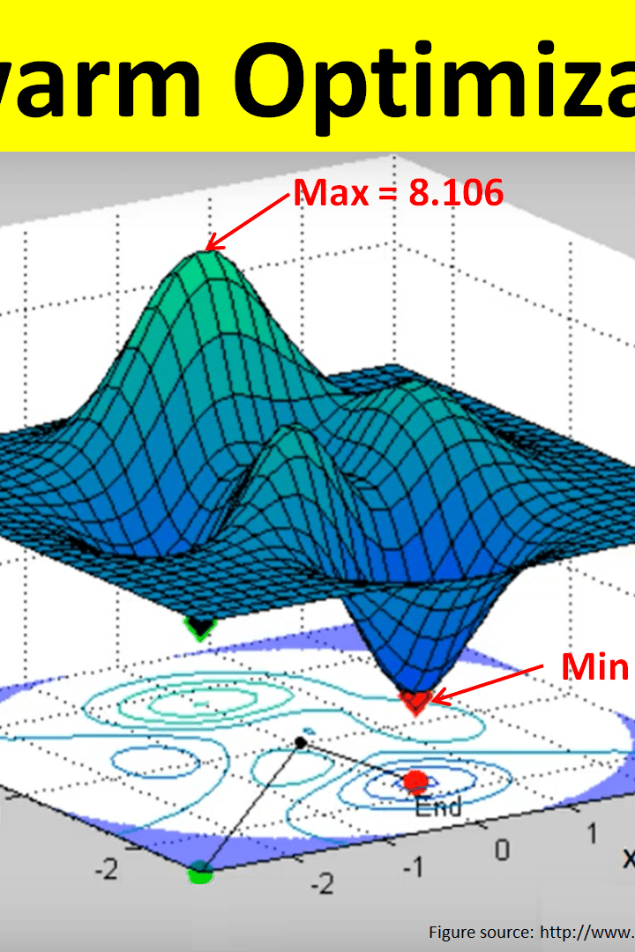
PSO ALGORITHM
The PSO algorithm is having four main components which will decide the efficiency of the given algorithm, namely, initial position, velocity, weight parameters, and the fitness function.
We will set the initial position and initial velocity so that the candidate solution obtained is the best one. To verify the authenticity of the arrived solution, we use the fitness function, and the fitness function ensures the PSO is optimized for the parameters we intended to.

Slide 6
Algorithm Formula
alpha×calcTotalTime(position)+(1−alpha)×calcMakespan(position):
Represents a weighted sum of two terms: one based on the total time taken and the other based on the makespan.
calcTotalTime(position):
This term calculates the total time taken by the system for a given task-to-VM mapping (position).It considers both the execution time (time spent computing) and the communication time (time spent transferring data) for each task on its assigned VM.
calcMakespan(position):
This term calculates the makespan for the system, which is the maximum time taken by any VM to complete its assigned tasks in the given task-to-VM mapping (position).It focuses on the overall time efficiency of the system, emphasizing the completion time of the longest-running VM.

Slide 7
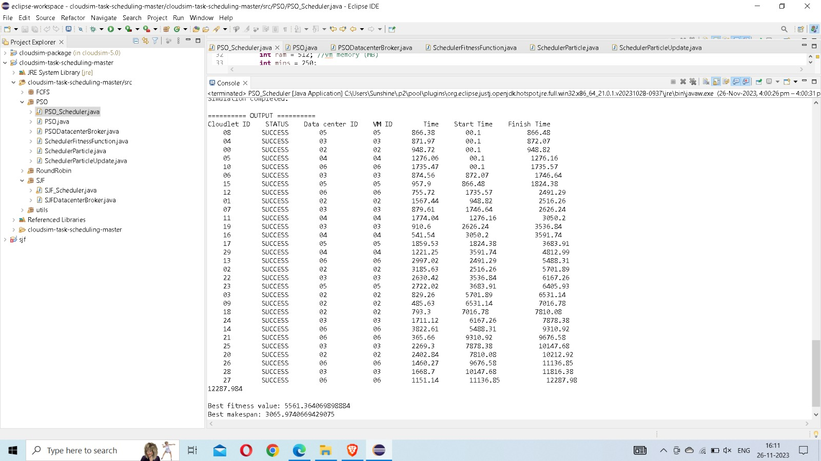

Slide 8
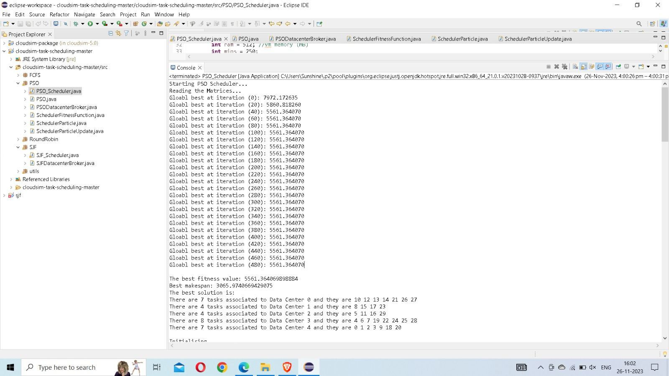

Slide 9
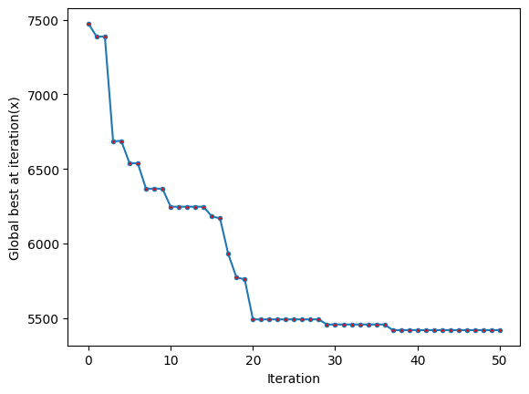
OUTPUT

Slide 10
Proposed Algorithm (Research paper)
Decision making system observs the current situation, takes actions and receives feedback. It observes how busy the system is, decides whether to add or remove resources and sees the impact.
Utilization Conditions:
Full Utilization: The system is using all available resources effectively.
Under-Provisioning: There's not enough capacity for the current workload.
Normal Utilization: The system is doing okay.
Define low threshold and high threshold for the system.

Slide 11
Decision making:
if Utilization>High Threshold then scale up for next state and receive feedback
If Low-Threshold< Utilization < High Threshold then no operation for next state and receive feedback
If Utilization <Low Threshold then scale down for next state and receive feedback.
This algorithm dynamically adapts resource allocation to optimize performance in response to changing workloads, demonstrating a basic reinforcement learning strategy for auto-scaling in cloud environments

Slide 12
REFERENCES
A Review of Particle Swarm Optimization in Cloud Computing
https://link.springer.com/chapter/10.1007/978-3-030-71485-7_5
A Gentle Introduction to Particle Swarm Optimization
https://machinelearningmastery.com/a-gentle-introduction-to-particle-swarm-optimization/
An Efficient Approach for Resource Auto-Scaling in Cloud Environments
https://www.researchgate.net/publication/305180276_An_Efficient_Approach_for_Resource_Auto-Scaling_in_Cloud_Environment
Cloud computing principles and paradigms by Rajkumar buyya

